Slide 1
FIELD PROJECT
SUBMITTED BY:-
Ch. siva sankar (231FA04D68)
A. karthik (231FA04F12)
U. Dinesh sai (231FA04F11)
J. Bhanua teja (231FA04F10)

Slide 2
Introduction
The digital transformation of the food service industry has given rise to food delivery applications that aim to simplify how users order and receive meals. The Food Delivery App project is a comprehensive platform designed to bridge the gap between users and local restaurants by providing an efficient, intelligent, and user-friendly system. The application streamlines the ordering process, offers real-time delivery tracking, and delivers personalized recommendations based on user preferences. The system not only focuses on convenience and speed but also aims to enhance user satisfaction through features such as dietary filtering, AI-driven suggestions, and an intuitive A interface.
As modern consumers increasingly rely on mobile and web applications to meet their dining needs, the project addresses the limitations of existing platforms and aims to deliver a smart, scalable, and feature-rich solution. This system is designed for both users and restaurants, ensuring seamless communication, efficient order management, and optimized logistics.

Slide 3
1.1 Problem Definition
In the current landscape of food delivery services, users often encounter several challenges:
Difficulty in locating restaurants that match specific dietary requirements, cuisine preferences, or budget constraints.
Inadequate filtering options that limit the ability to narrow down suitable meal choices.
Lack of real-time tracking features that result in uncertainty about order status and delivery time.
Generic promotional offers that are not tailored to individual user behavior or preferences.
Poor user interface designs in some platforms that hinder smooth navigation and usability.
These issues collectively reduce customer satisfaction and may deter users from using digital food ordering systems regularly. Additionally, restaurant owners struggle to manage orders efficiently, especially during peak hours, and delivery personnel often face logistical issues related to optimal routing and delivery timelines

Slide 4
1.2 Existing System
Popular food delivery applications like Zomato, Swiggy, Uber Eats, and DoorDash provide basic functionalities such as browsing restaurant menus, placing orders, and receiving estimated delivery times. However, they often fall short in the following areas:
Limited filtering options for users with allergies, dietary restrictions (e.g., vegan, keto, gluten-free), or specific taste preferences.
Static recommendations that do not evolve based on user behavior, purchase history, or meal ratings.
Inconsistent real-time tracking systems that provide vague or delayed updates.
Delivery route planning is often generic, not accounting for real-time traffic data or order prioritization.
Lack of personalized experiences, such as meal suggestions based on past orders, time of day, or local trends.
As a result, users do not receive an optimized or deeply personalized experience, and restaurants and delivery agents do not have the tools to maximize efficiency and performance.

Slide 5
1.3 Proposed System
The proposed Food Delivery App is a smart and user-centric platform that addresses the deficiencies of existing systems and introduces advanced features to elevate the food ordering experience. The key highlights include:
Advanced Search & Filtering: Users can search for restaurants and dishes using multiple parameters, including cuisine type, dietary needs, budget range, distance, delivery time, and user reviews.
AI-Driven Personalization: The system leverages machine learning algorithms to offer personalized meal recommendations based on previous orders, time-based patterns, location, and user preferences.
Real-Time Tracking: Users can track their order from preparation to delivery using integrated GPS tracking. This includes driver location, estimated delivery time, and real-time updates via push notifications

Slide 6
Optimized Delivery Routes: The system calculates the fastest and most efficient delivery paths using traffic data, weather conditions, and delivery load, reducing delivery delays.
Promotions & Loyalty: Personalized promotions and loyalty programs are tailored to individual user behavior, encouraging repeat orders and enhancing user retention.
Restaurant & Delivery Dashboard: Restaurants can manage incoming orders, update menu availability, and monitor delivery operations. Delivery personnel have access to optimized routes and delivery schedules.

Slide 7
1.4 Literature Review
Extensive research in the domain of online food delivery platforms reveals several critical challenges and innovations that inform the design of this system.
Delivery Time Prediction: Studies emphasize the complexity of accurately estimating delivery times, which requires real-time data integration from kitchens, delivery staff, and traffic systems. [Ghosh et al., 2021]
Dynamic Pricing & Promotions: Research indicates that pricing strategies and dynamic offers influence user behavior, and data-driven models significantly improve marketing efficiency. [Kumar & Dey, 2020]
AI Recommendations: Various machine learning models, including collaborative filtering and content-based filtering, are employed in modern systems to generate user-specific recommendations that improve order frequency. [Zhang et al., 2022]
User Interface (UI) and Experience (UX): Studies consistently highlight that a clean, intuitive UI with minimal steps to order is essential for user satisfaction. Features such as predictive search, easy navigation, and visual menus are highly favored.

Slide 8
System Requirements 2.1 Hardware & Software Requirements
On the software side, the system uses HTML, CSS, and JavaScript for frontend development, ensuring a responsive interface compatible with various screen sizes. The backend is powered by Node.js and MongoDB (or an equivalent database) to handle order processing and user management efficiently. APIs like Google Maps API for real-time tracking and payment gateways (Stripe, PayPal, etc.) for secure transactions provide seamless integration.Users require a stable internet connection to access the web and mobile applications, making it compatible with devices that have at least 4GB RAM and a dual-core processor for optimal performance.
2.2 Software Requirements Specification (SRS)
The Delivery App should support key functionalities to enhance user experience. This includes:
Order placement with real-time status updates.
User account management for profile customization, saved addresses, and order history.
Secure payment integration for seamless transactions using multiple payment options.
Admin panel for managing orders, deliveries, and user support efficiently.
The system must ensure smooth navigation, quick response times, and secure data handling to maintain usability and reliability

Slide 9
System Design
3.1 Modules of System
· User Management: Handles user login, registration, and profile customization, ensuring a personalized experience.
· Recipe Search and Filtering: Provides search functionality with filters for ingredients, cuisine, dietary restrictions, and meal types.
· Shopping List Management: Allows users to add ingredients to a shopping list for easy grocery planning.
· Meal Planning: Supports users in scheduling meals by organizing selected recipes into weekly or daily plans.
· Ratings and Reviews: Enables users to rate and review delivery, fostering engagement and feedback sharing.

Slide 10
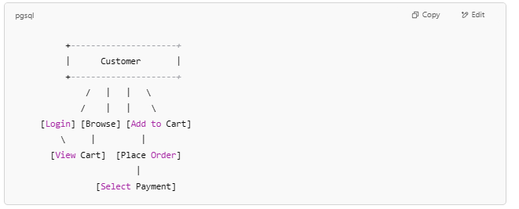
3.2 UML DIAGRAMS
USECASE DIAGRAM
Purpose: Shows how users (actors) interact with the system's functions.
Actors:
Customer (Main user)
Use Cases:
Register/Login
Browse Menu
Add to Cart
View Cart
Choose Payment Method
Place Order
Track Order

Slide 11
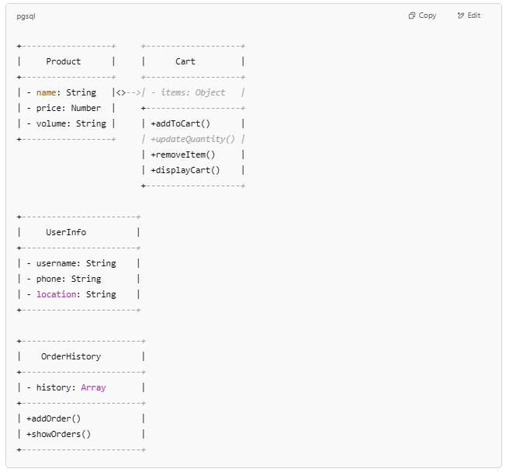
CLASS DIAGRAM Purpose: Represents the static structure — classes and their relationships.

Slide 12
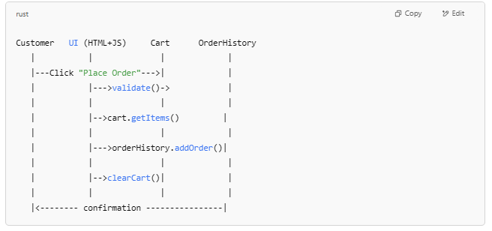
SEQUENCE DIAGRAM Purpose: Shows interaction over time between user and system components.

Slide 13
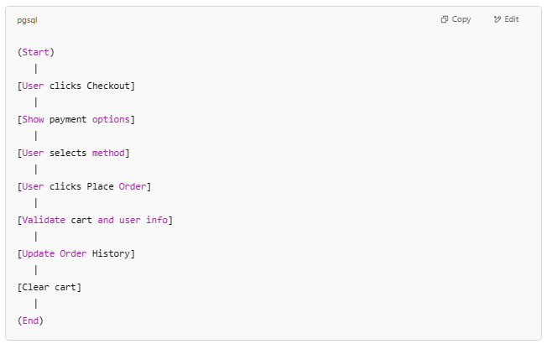
ACTIVITY DIAGRAM: Purpose: Describes the flow of actions during checkout.

Slide 14
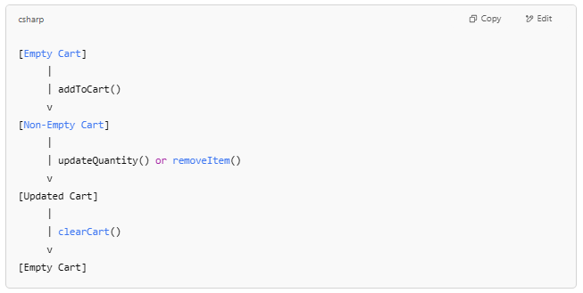
STATE DIAGRAM: Purpose: Shows state transitions of the cart.

Slide 15
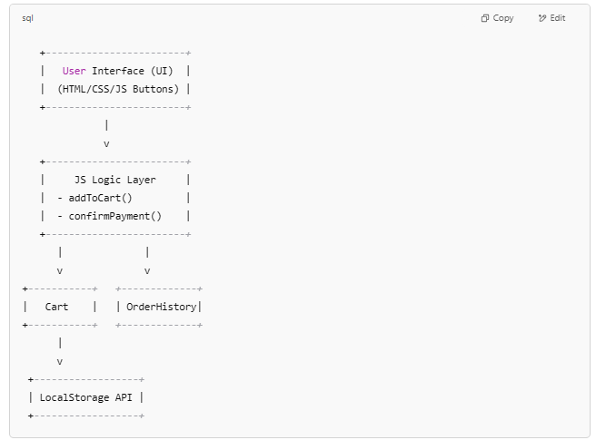
COMPONENT DIAGRAM: Purpose: Shows high-level components and dependencies in the system.

Slide 16
Implementation

Slide 17
Login Functionality:
Valid Login Credentials:
Enter a name in the "Name" field (e.g., "John Doe").
Enter a phone number in the "Phone Number" field (e.g., "1234567890").
Enter a location in the "Location" field (e.g., "Hyderabad").
Click the "Login" button.
Expected Result: An alert message "Login successful!" should appear. The login container should disappear, and the main content (welcome message, product list) should become visible. The userInfo object in the JavaScript should contain the entered details.
Missing Name:
Leave the "Name" field empty.
Enter a phone number and location.
Click the "Login" button.
Expected Result: An alert message "Please fill in all fields." should appear. The login container should remain visible, and the main content should remain hidden.
Missing Phone Number:
Enter a name and location.
Leave the "Phone Number" field empty.
Click the "Login" button.
Expected Result: An alert message "Please fill in all fields." should appear. The login container should remain visible, and the main content should remain hidden.

Slide 18
Missing Location:
Enter a name and phone number.
Leave the "Location" field empty.
Click the "Login" button.
Expected Result: An alert message "Please fill in all fields." should appear. The login container should remain visible, and the main content should remain hidden.
All Fields Empty:
Leave all login fields empty.
Click the "Login" button.
Expected Result: An alert message "Please fill in all fields." should appear. The login container should remain visible, and the main content should remain hidden.

Slide 19
Product Display and Filtering
Initial Product Load:
After a successful login, observe the "Available Dishes" section.
Expected Result: All the products defined in the products array should be displayed, each with its image placeholder, name, volume, price, and an "Add to Cart" button.
Filtering with Existing Product Name (Case-insensitive):
Enter "burger" (lowercase) in the search input field.
Click the "Search" button.
Expected Result: Only the "Burger" product should be displayed.
Filtering with a Partial Existing Product Name:
Enter "fri" in the search input field.
Click the "Search" button.
Expected Result: Only the "French Fries" product should be displayed.
Filtering with a Non-Existing Product Name:
Enter "samosa" in the search input field.
Click the "Search" button.
Expected Result: The "Available Dishes" section should be empty (or display a "no products found" message if you were to implement that).
Clearing the Search Filter:
After performing a filter, clear the search input field.
Expected Result: All the original products should be displayed again.

Slide 20
Adding Items to Cart:
Adding a Single Item:
Click the "Add to Cart" button for "Burger".
Expected Result: The "Your Order" section should now display "Burger - $2.00 x 1" with a quantity input (set to 1) and a "Remove" button. The total should be "$2.00". The "Checkout" button should be enabled.
Adding Multiple Items (Different Products):
Click "Add to Cart" for "Burger".
Click "Add to Cart" for "Pizza".
Expected Result: The "Your Order" section should display both "Burger..." and "Pizza..." items with their respective prices and quantities (both 1). The total should be $7.00.
Adding Multiple Quantities of the Same Item:
Click "Add to Cart" for "Burger" twice.
Expected Result: The "Your Order" section should display "Burger - $2.00 x 2". The quantity input should show "2". The total should be "$4.00".

Slide 21
Updating Cart Quantity:
Increasing Quantity:
Add "Burger" to the cart.
In the quantity input field for "Burger", change the value from "1" to "3" and either press Enter or click away.
Expected Result: The displayed quantity for "Burger" should update to "3", and the total should be recalculated to "$6.00".
Decreasing Quantity:
Add "Burger" to the cart (quantity 2 or more).
In the quantity input field for "Burger", change the value to "1".
Expected Result: The displayed quantity should update to "1", and the total should be recalculated accordingly.
Setting Quantity to Zero or Negative:
Add "Burger" to the cart.
In the quantity input field, enter "0" or "-1" and either press Enter or click away.
Expected Result: The quantity should automatically reset to "1" (as per your updateQuantity function). The total should be updated accordingly.

Slide 22
Removing Items from Cart:
Removing a Single Item:
Add "Burger" to the cart.
Click the "Remove" button next to "Burger" in the "Your Order" section.
Expected Result: The "Burger" item should be removed from the "Your Order" section. The total should be "$0.00". The "Checkout" button should be disabled.
Removing One of Multiple Items:
Add "Burger" and "Pizza" to the cart.
Click the "Remove" button next to "Burger".
Expected Result: Only the "Pizza" item should remain in the "Your Order" section, with its original quantity and price. The total should reflect only the price of the pizza.

Slide 23
Viewing Order History:
Viewing Empty Order History:
Log in and click the "Your Orders" link in the menu.
Expected Result: The "Your Previous Orders" section should appear, displaying "No orders found."
Viewing Order History After Placing Orders:
Log in.
Place one or more orders (as per the "Placing Order" test cases).
Click the "Your Orders" link in the menu.
Expected Result: The "Your Previous Orders" section should display the items from the previously placed order(s), showing the product name and quantity for each item.
Closing Order History:
After viewing the order history, click the "OK" button within the "Your Previous Orders" section.
Expected Result: The "Your Previous Orders" section should disappear.

Slide 24
Menu Toggle:
Opening the Menu:
After logging in, click the "☰" menu button in the header.
Expected Result: The dropdown menu with "Products", "Your Orders", and "Contact" links should become visible.
Closing the Menu (Clicking the Button Again):
With the menu open, click the "☰" menu button again.
Expected Result: The dropdown menu should disappear.
Closing the Menu (Clicking Outside):
With the menu open, click anywhere outside the menu area.
Expected Result: The dropdown menu should disappear (note: this behavior is not explicitly coded in your provided script, so this test case might fail unless you add this functionality).
These test cases should give you a good starting point for verifying the functionality of your web application.

Slide 25
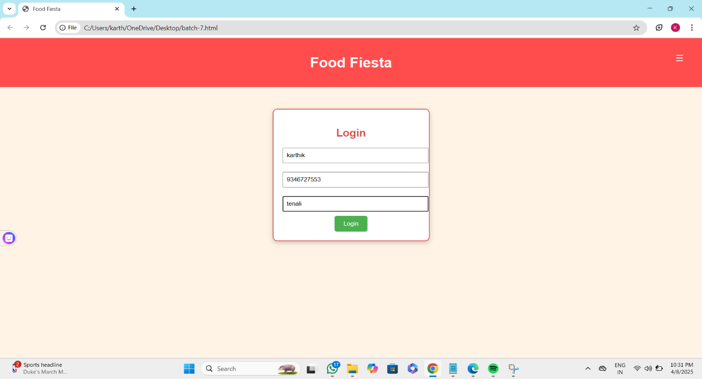
Results

Slide 26
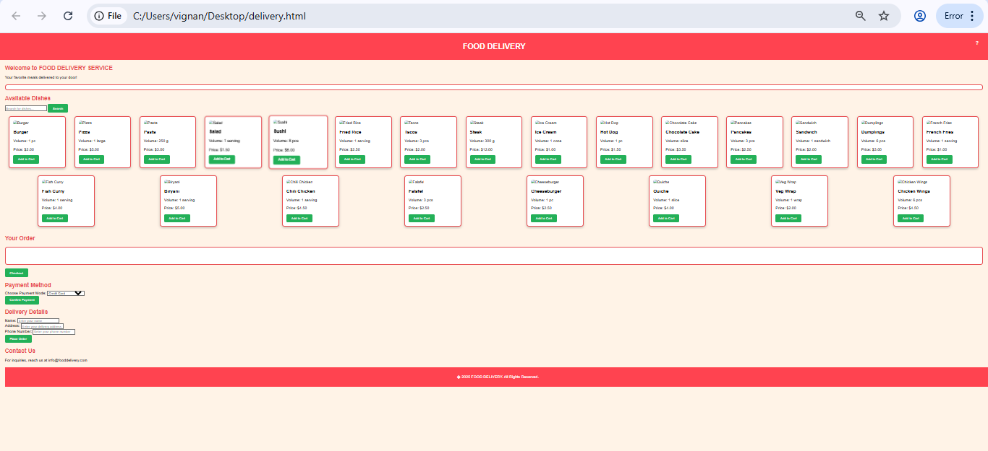

Slide 27
Conclusion
The Delivery App provides an efficient solution to common challenges in ordering and receiving deliveries by offering a user-friendly and customizable platform. With features such as real-time ordering , multiple payment options, route optimization, and delivery management, the system caters to diverse user needs. Built using HTML, CSS, and JavaScript, the responsive design ensures seamless accessibility across devices, allowing users to place and track orders conveniently anytime, anywhere. By incorporating ratings, reviews, and social sharing, the platform fosters community engagement and helps users make informed decisions while enhancing the overall delivery experience.

Slide 28
References
Includes research papers, API documentation, and relevant web development resources such as w3 schools,..etc.,

